Slide 1
Decomposition of Graph Breadth-First Search

Slide 2

Decomposition of Graph
The remaining of this chapter covers:
graphs, with
Depth-First Search, and
Breadth-First Search, and
Topological Sorting
Strong Connected Components
Fake Coin Problem
Interpolation Search

Slide 3

Decrease-by-one technique – Recall
Graph:
A directed graph or digraph is a graph with directions specified for all its edges.
The adjacency matrix and adjacency lists are still two principal means of representing a digraph.
Depth-First Search and Breadth-First Search Algorithms
Viewed as applications of the decrease-by-one technique.
Doing their main job of visiting vertices and traversing edges of a graph.

Slide 4

Decrease-by-one technique
Breadth-First Search

Slide 5

Breadth-First Search
Given a graph G = (V, E) and a distinguished source vertex s,
Breadth-first search (BFS) explores the edges of G to “discover” (visit) every vertex that is reachable from s.
produces a breadth-first tree with root s that contains all reachable vertices.
computes the distance (smallest number of edges) from s to each reachable vertex.
For any vertex v reachable from s, the simple path in the breadth-first tree from s to v is a shortest path from s to v in G [ that is, a path containing the smallest number of edges].
The breadth-first search (BFS) algorithm works on both direct and undirected graphs.

Slide 6

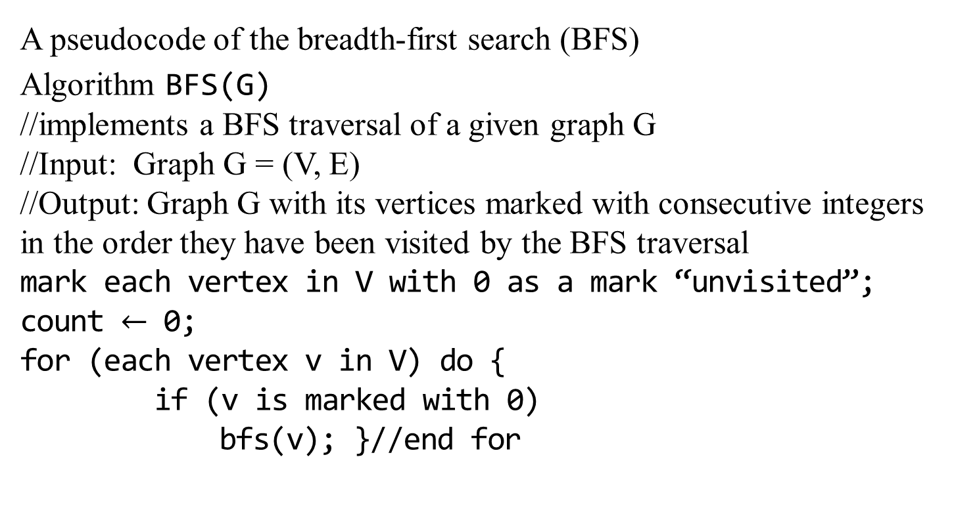
Breadth-First Search
A pseudocode of the breadth-first search (BFS)
Algorithm BFS(G)
//implements a BFS traversal of a given graph G
//Input: Graph G = (V, E)
//Output: Graph G with its vertices marked with consecutive integers in the order they have been visited by the BFS traversal
mark each vertex in V with 0 as a mark “unvisited”;
count $←$ 0;
for (each vertex v in V) do {
if (v is marked with 0)
bfs(v); }//end for

Slide 7
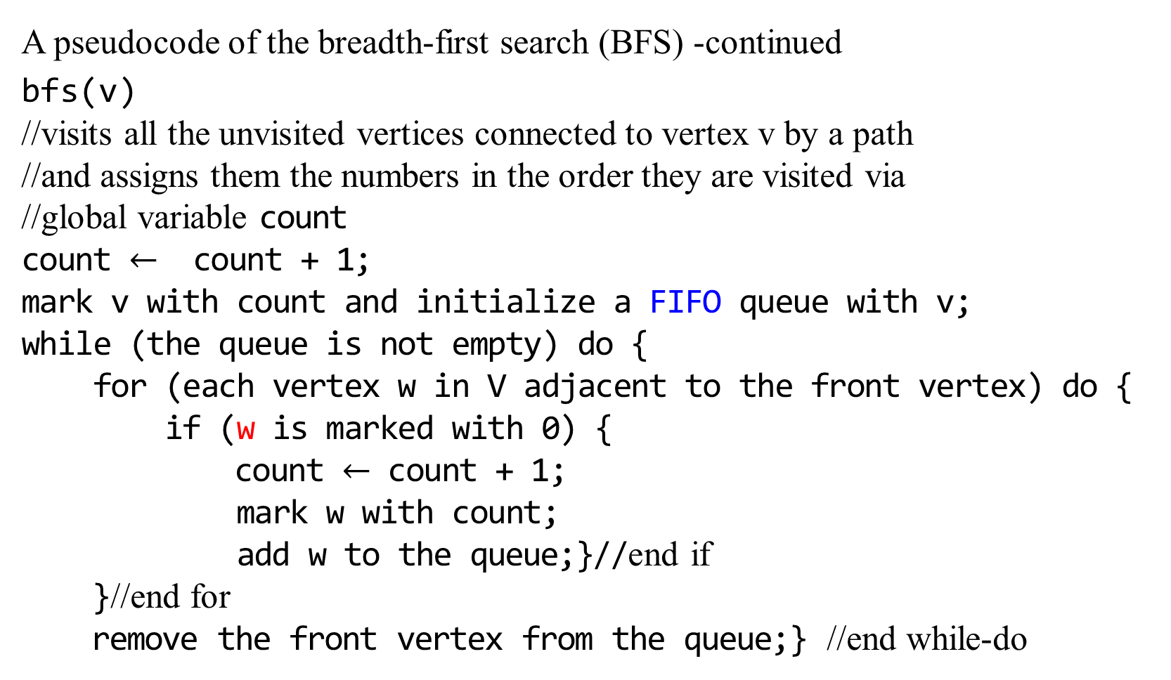
Breadth-First Search
A pseudocode of the breadth-first search (BFS) -continued
bfs(v)
//visits all the unvisited vertices connected to vertex v by a path
//and assigns them the numbers in the order they are visited via
//global variable count
count $←$ count + 1;
mark v with count and initialize a FIFO queue with v;
while (the queue is not empty) do {
for (each vertex w in V adjacent to the front vertex) do {
if (w is marked with 0) {
count $←$ count + 1;
mark w with count;
add w to the queue;}//end if
}//end for
remove the front vertex from the queue;} //end while-do

Slide 8
Breadth-First Search
The breadth-first search (BFS) algorithm works on both direct and undirected graphs.
The BFS algorithm discovers all vertices at distance k from s before discovering any vertices at distance k+1.
S
A1 A2 A3
A2 A3 B1 B2 B3
A3 B1 B2 B3 B4 B5 B6
B1 B2 B3 B4 B5 B6 B7 B8 B9

Slide 9
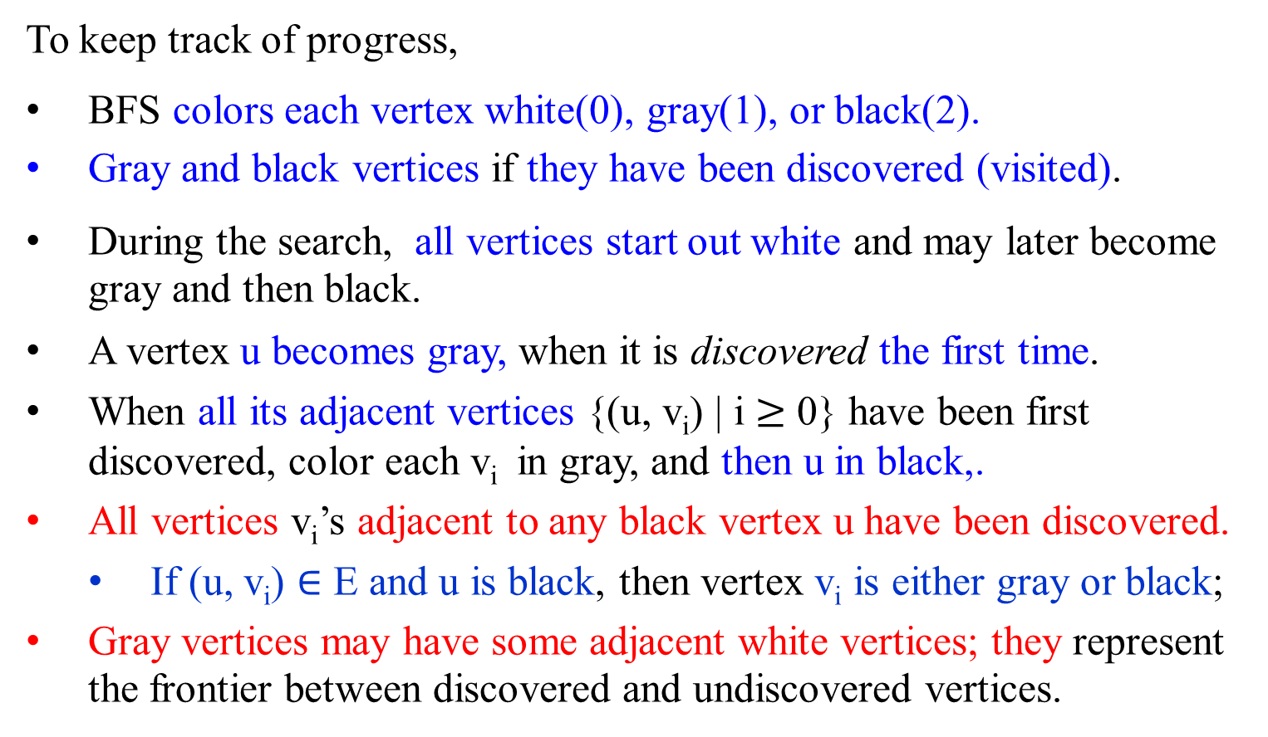
Breadth-First Search
To keep track of progress,
BFS colors each vertex white(0), gray(1), or black(2).
Gray and black vertices if they have been discovered (visited).
During the search, all vertices start out white and may later become gray and then black.
A vertex u becomes gray, when it is discovered the first time.
When all its adjacent vertices {(u, v_{i}) | i $≥$ 0} have been first discovered, color each v_{i} in gray, and then u in black,.
All vertices v_{i}’s adjacent to any black vertex u have been discovered.
If (u, v_{i}) $∈$ E and u is black, then vertex v_{i} is either gray or black;
Gray vertices may have some adjacent white vertices; they represent the frontier between discovered and undiscovered vertices.

Slide 10
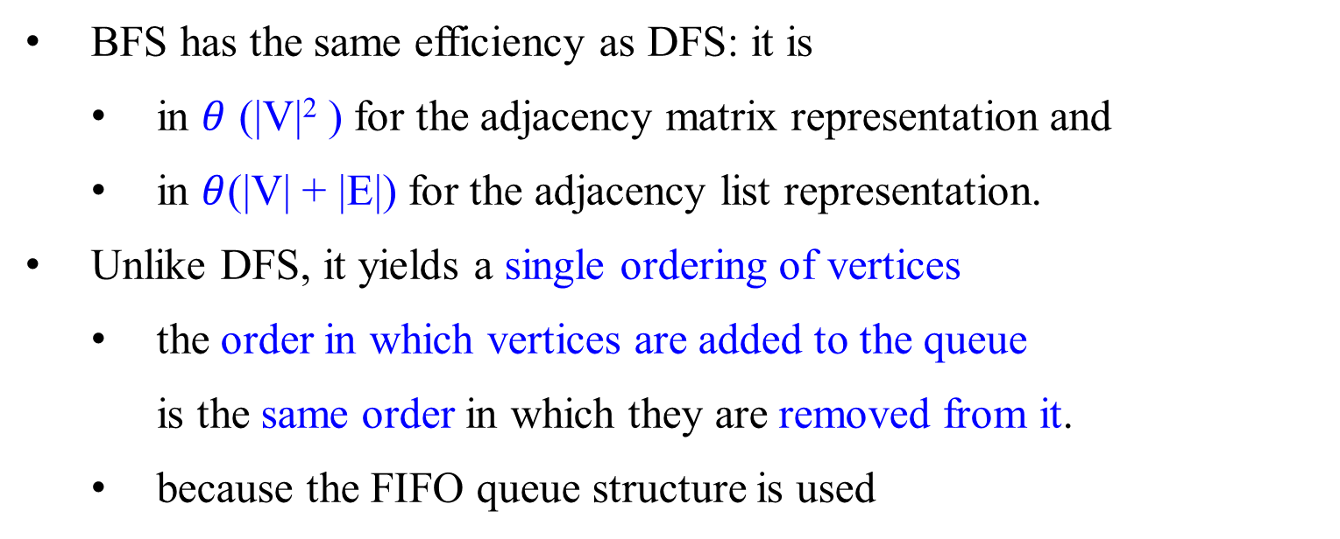
Breadth-First Search
BFS has the same efficiency as DFS: it is
in $θ$ (|V|² ) for the adjacency matrix representation and
in $θ$(|V| + |E|) for the adjacency list representation.
Unlike DFS, it yields a single ordering of vertices
the order in which vertices are added to the queue
is the same order in which they are removed from it.
because the FIFO queue structure is used

Slide 11
Breadth-First Search
Similarly to a DFS traversal, accompanying a BFS traversal, the so-called breadth-first search forest is constructed
The traversal’s starting vertex serves as the root of the first tree in such a forest.
Whenever a new unvisited vertex v is reached for the first time from a vertex u, a tree edge (u, v) is generated.
A cross edge (u, v) is generated, if there is an edge (u, v), leading from u to a previously visited vertex v, other than its immediate predecessor (i.e., its parent in the tree).

Slide 12

Depth-First Search
Example 3.8: An example of a depth-first search traversal, with the traversal’s stack and corresponding depth-first search forest shown as well.
g
h
Input: An adjacency list
a → c → d → e
b → e → f
c → a → d → f
d → a → c
e → a → b → f
f → b → c → e
g → h → j
h → g → i
i → h → j
j → g → i
c
a
e
d
c
f
b
j
i
(a) Graph

Slide 13
Depth-First Search
Consider again the traversal of the given graph in example 3.8. We have:
Parenthesis structure: (push-onto pop-off) or (discover finish) order
(a (c ( d d) (f (b (e e) b) f) c ) a) (g (h (i (j j) i) h) g)
(c) DFS forest (with the tree edges
shown with solid lines and the
back edges shown with dashed lines
 |  | e_{6, 2}
 |  | b_{5, 3} |  | j_{10, 7}
d_{3, 1} |  | f_{4, 4} |  | i_{9, 8}
c_{2, 5} |  | c_{2, 5} |  | h_{8, 9}
a_{1, 6} |  | a_{1, 6} |  | g_{7, 10}
a g
c h
d f i
b j
e

Slide 14
Breadth-First Search
Example 3.8: Let have breadth-first search traversal, with the traversal’s queue and corresponding breadth-first search forest shown as well.
g
h
Input: An adjacency list, with 0
a0 → c → d → e
b0 → e → f
c0 → a → d → f
d0 → a → c
e0 → a → b → f
f0 → b → c → e
g0 → h → j
h0 → g → i
i0 → h → j
j0 → g → i
a
e
d
c
f
b
j
i
(a) Graph
∞
FIFO Queue

Slide 15
Breadth-First Search
Example 3.8: Let have breadth-first search traversal, with the traversal’s queue and corresponding breadth-first search forest shown as well.
g
h
Input: An adjacency list
a1 → c → d → e
b0 → e → f
c0 → a → d → f
d0 → a → c
e0 → a → b → f
f0 → b → c → e
g0 → h → j
h0 → g → i
i0 → h → j
j0 → g → i
a
e
d
c
f
b
a
j
i
(a) Graph
a
FIFO Queue

Slide 16
Breadth-First Search
Example 3.8: Let have breadth-first search traversal, with the traversal’s queue and corresponding breadth-first search forest shown as well.
g
h
Input: An adjacency list
a2 → c → d → e
b0 → e → f
c1 → a → d → f
d1 → a → c
e1 → a → b → f
f0 → b → c → e
g0 → h → j
h0 → g → i
i0 → h → j
j0 → g → i
a
e
d
c
f
b
a
j
i
(a) Graph
c
d
e
c d e
Either a variable of 3 integer values or 3 colors is needed.

Slide 17
Breadth-First Search
Example 3.8: Let have breadth-first search traversal, with the traversal’s queue and corresponding breadth-first search forest shown as well.
g
h
Input: An adjacency list
a2 → c → d → e
b0 → e → f
c2 → a → d → f
d1 → a → c
e1 → a → b → f
f0 → b → c → e
g0 → h → j
h0 → g → i
i0 → h → j
j0 → g → i
a
e
d
c
f
b
a
j
i
(a) Graph
c
d
e
d e f
f
FIFO Queue

Slide 18
Breadth-First Search
Example 3.8: Let have breadth-first search traversal, with the traversal’s queue and corresponding breadth-first search forest shown as well.
g
h
Input: An adjacency list
a2 → c → d → e
b0 → e → f
c2 → a → d → f
d2 → a → c
e1 → a → b → f
f1 → b → c → e
g0 → h → j
h0 → g → i
i0 → h → j
j0 → g → i
a
e
d
c
f
b
a
j
i
(a) Graph
c
d
e
e f
f
FIFO Queue

Slide 19
Breadth-First Search
Example 3.8: Let have breadth-first search traversal, with the traversal’s queue and corresponding breadth-first search forest shown as well.
g
h
Input: An adjacency list
a2 → c → d → e
b1 → e → f
c2 → a → d → f
d2 → a → c
e2 → a → b → f
f1 → b → c → e
g0 → h → j
h0 → g → i
i0 → h → j
j0 → g → i
a
e
d
c
f
b
a
j
i
(a) Graph
c
d
e
f b
f
b
FIFO Queue

Slide 20
Breadth-First Search
Example 3.8: Let have breadth-first search traversal, with the traversal’s queue and corresponding breadth-first search forest shown as well.
g
h
Input: An adjacency list
a2 → c → d → e
b1 → e → f
c2 → a → d → f
d2 → a → c
e2 → a → b → f
f2 → b → c → e
g0 → h → j
h0 → g → i
i0 → h → j
j0 → g → i
a
e
c
f
a
d
b
j
i
c
d
e
(a) Graph
b
f
b
FIFO Queue

Slide 21
Breadth-First Search
Example 3.8: Let have breadth-first search traversal, with the traversal’s queue and corresponding breadth-first search forest shown as well.
g
h
Input: An adjacency list
a2 → c → d → e
b2 → e → f
c2 → a → d → f
d2 → a → c
e2 → a → b → f
f2 → b → c → e
g0 → h → j
h0 → g → i
i0 → h → j
j0 → g → i
a
e
c
f
b
a
d
j
i
c
d
e
(a) Graph
∞
f
b
FIFO Queue

Slide 22
Breadth-First Search
(b) Traversal’s queue, with the numbers indicating the order in which the vertices were visited, i.e. added to (or removed from) the queue. And hence the order in which vertices are added to the queue is the same order in which they are removed from it.
a₁ c₂ d₃ e₄ f₅ b₆
g₇ h₈ j₉ i₁₀
a
g
c
d
e
h
j
f
b
i
(c) BFS forest (with the tree edges shown with solid lines and the cross edges shown with dotted lines).

Slide 23
Breadth-First Search
As to the structure of a BFS forest of an undirected graph,
it can also have two kinds of edges:
Tree edges:
used to reach previously unvisited vertices.
Cross edges:
used to connect vertices to those visited before,
connect vertices either on the same or adjacent levels of a BFS tree.
but, unlike back edges in a DFS tree,

Slide 24
Breadth-First Search
Use BFS to check
connectivity and
acyclicity
of a graph, essentially in the same manner as DFS can.
BFS is not applicable for several less straightforward applications such as finding articulation points.

Slide 25
Breadth-First Search
Efficiency of the algorithm BFS(G):
Breadth-first search has the same efficiency as depth-first search:
it is
in Θ(|V|² ) for the adjacency matrix representation and
in Θ(|V| + |E|) for the adjacency list representation.

Slide 26
Breadth-First Search
BSF can be helpful in some situations where DFS cannot.
BFS can be used for finding a path with the fewest number of edges between two given vertices.
Start a BFS traversal at one of the two vertices given and
stop the BFS traversal when the other vertex is reached.
The simple path from the root of the BFS tree to the second vertex is the path sought.
Example 3.8: the path a – e – b in the undirected graph has the fewest number of edges among all the paths between vertices a and b.
The correctness of this application appears to stem immediately from the way BFS operates; but a mathematical proof of its validity is not quite obvious.
3.11.? Replaced 3,8

Slide 27
Breadth-First Search (BFS)

Slide 28

Breadth-First Search on Undirected Graph
y z s t
x w v u
?/?
?/?
?/?
?/?
Figure 3.11
∞
?/?
?/?
?/?
?/?
FIFO Queue Q
Adjacency List Representation
s | $$→$$ | z | $$→$$ | w | $$→$$ | v |  |  |  |  | s0 | $$→$$ | z | $$→$$ | w | $$→$$ | v
t | $$→$$ | u | $$→$$ | v |  |  |  |  |  |  | t0 | $$→$$ | u | $$→$$ | v
u | $$→$$ | t | $$→$$ | v |  |  |  |  |  |  | u0 | $$→$$ | t | $$→$$ | v
v | $$→$$ | t | $$→$$ | u | $$→$$ | s | $$→$$ | w | ⟾ |  | v0 | $$→$$ | t | $$→$$ | u | $$→$$ | s | $$→$$ | w
w | $$→$$ | v | $$→$$ | s | $$→$$ | z | $$→$$ | x |  |  | w0 | $$→$$ | v | $$→$$ | s | $$→$$ | z | $$→$$ | x
x | $$→$$ | w | $$→$$ | z | $$→$$ | y |  |  |  |  | x0 | $$→$$ | w | $$→$$ | z | $$→$$ | y
y | $$→$$ | x | $$→$$ | z |  |  |  |  |  |  | y0 | $$→$$ | x | $$→$$ | z
z | $$→$$ | y | $$→$$ | x | $$→$$ | w | $$→$$ | s |  |  | z0 | $$→$$ | y | $$→$$ | x | $$→$$ | w | $$→$$ | s

Slide 29
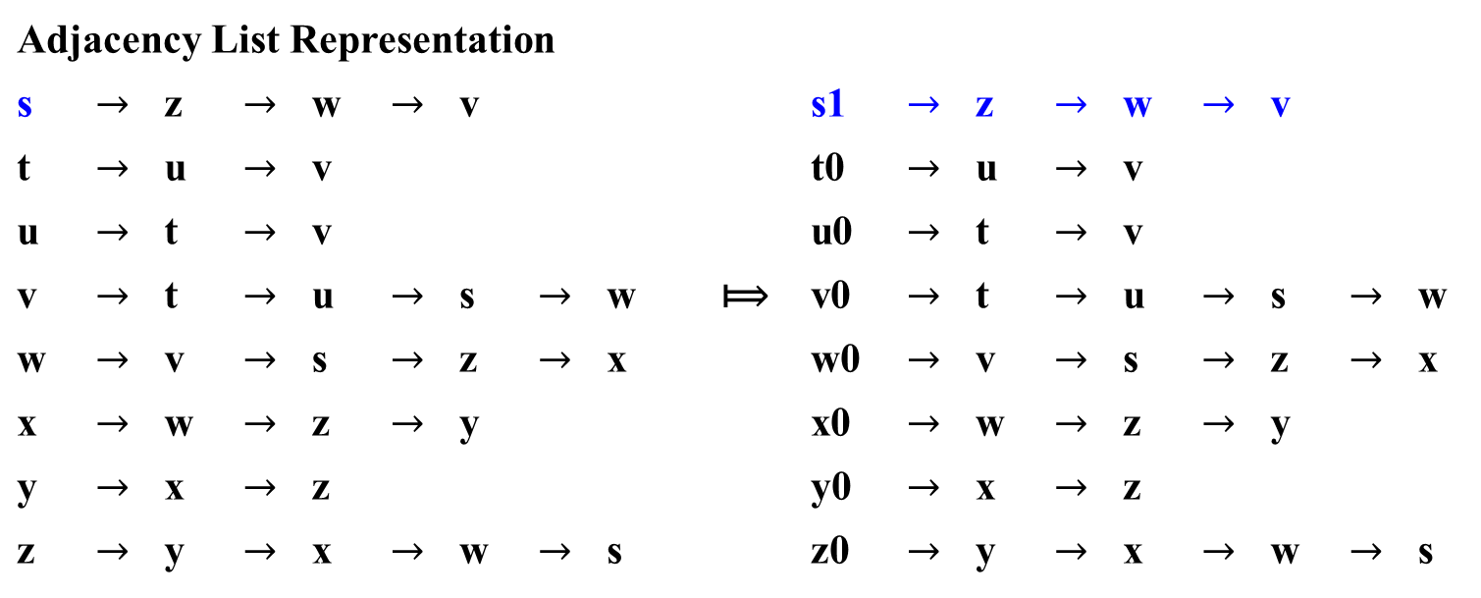
Breadth-First Search on Undirected Graph
Figure 3.11
y z s t
x w v u
?/?
?/?
1/?
?/?
s
FIFO Queue Q
?/?
?/?
?/?
?/?
s
Adjacency List Representation
s | $$→$$ | z | $$→$$ | w | $$→$$ | v |  |  |  |  | s1 | $$→$$ | z | $$→$$ | w | $$→$$ | v
t | $$→$$ | u | $$→$$ | v |  |  |  |  |  |  | t0 | $$→$$ | u | $$→$$ | v
u | $$→$$ | t | $$→$$ | v |  |  |  |  |  |  | u0 | $$→$$ | t | $$→$$ | v
v | $$→$$ | t | $$→$$ | u | $$→$$ | s | $$→$$ | w | ⟾ |  | v0 | $$→$$ | t | $$→$$ | u | $$→$$ | s | $$→$$ | w
w | $$→$$ | v | $$→$$ | s | $$→$$ | z | $$→$$ | x |  |  | w0 | $$→$$ | v | $$→$$ | s | $$→$$ | z | $$→$$ | x
x | $$→$$ | w | $$→$$ | z | $$→$$ | y |  |  |  |  | x0 | $$→$$ | w | $$→$$ | z | $$→$$ | y
y | $$→$$ | x | $$→$$ | z |  |  |  |  |  |  | y0 | $$→$$ | x | $$→$$ | z
z | $$→$$ | y | $$→$$ | x | $$→$$ | w | $$→$$ | s |  |  | z0 | $$→$$ | y | $$→$$ | x | $$→$$ | w | $$→$$ | s

Slide 30
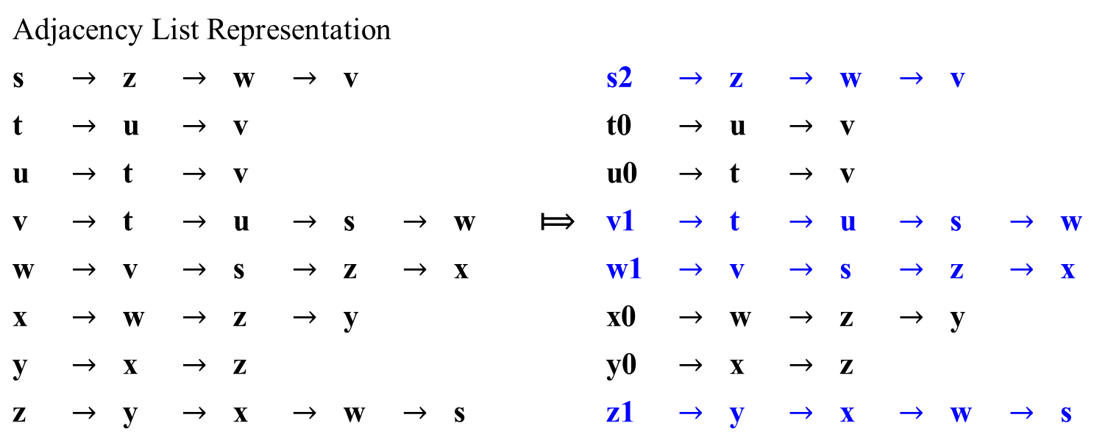
Breadth-First Search on Undirected Graph
y z s t
x w v u
Figure 3.11
?/?
2/?
1/2
?/?
z w v
FIFO Queue Q
?/?
2/?
2/?
?/?
s
Adjacency List Representation
s | $$→$$ | z | $$→$$ | w | $$→$$ | v |  |  |  |  | s2 | $$→$$ | z | $$→$$ | w | $$→$$ | v
t | $$→$$ | u | $$→$$ | v |  |  |  |  |  |  | t0 | $$→$$ | u | $$→$$ | v
u | $$→$$ | t | $$→$$ | v |  |  |  |  |  |  | u0 | $$→$$ | t | $$→$$ | v
v | $$→$$ | t | $$→$$ | u | $$→$$ | s | $$→$$ | w | ⟾ |  | v1 | $$→$$ | t | $$→$$ | u | $$→$$ | s | $$→$$ | w
w | $$→$$ | v | $$→$$ | s | $$→$$ | z | $$→$$ | x |  |  | w1 | $$→$$ | v | $$→$$ | s | $$→$$ | z | $$→$$ | x
x | $$→$$ | w | $$→$$ | z | $$→$$ | y |  |  |  |  | x0 | $$→$$ | w | $$→$$ | z | $$→$$ | y
y | $$→$$ | x | $$→$$ | z |  |  |  |  |  |  | y0 | $$→$$ | x | $$→$$ | z
z | $$→$$ | y | $$→$$ | x | $$→$$ | w | $$→$$ | s |  |  | z1 | $$→$$ | y | $$→$$ | x | $$→$$ | w | $$→$$ | s
z
w
v

Slide 31
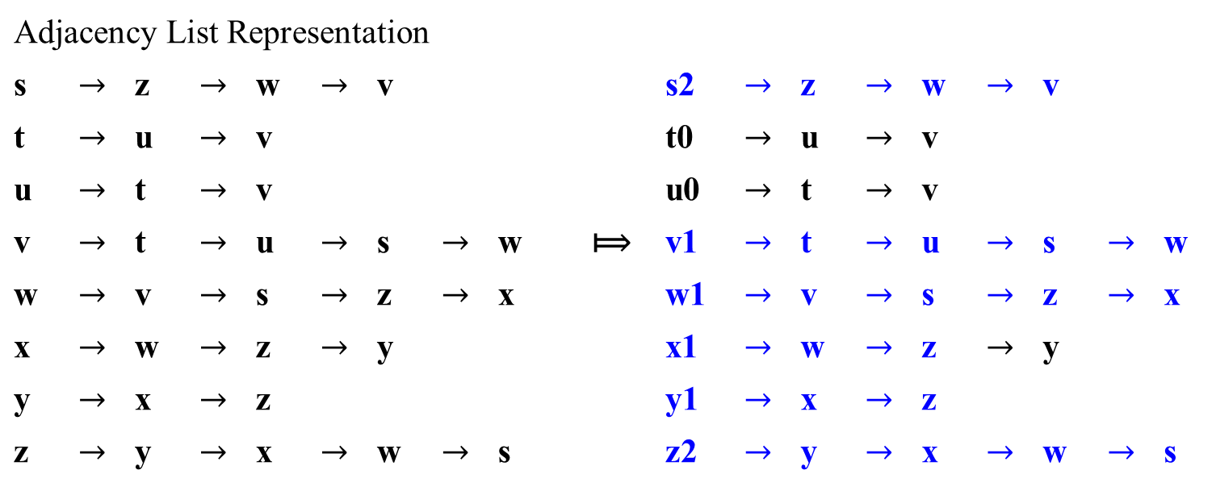
Breadth-First Search on Undirected Graph
y z s t
x w v u
w v y x
3/?
2/3
1/2
?/?
FIFO Queue Q
s
3/?
2/?
2/?
?/?
z
w
v
Adjacency List Representation
s | $$→$$ | z | $$→$$ | w | $$→$$ | v |  |  |  |  | s2 | $$→$$ | z | $$→$$ | w | $$→$$ | v
t | $$→$$ | u | $$→$$ | v |  |  |  |  |  |  | t0 | $$→$$ | u | $$→$$ | v
u | $$→$$ | t | $$→$$ | v |  |  |  |  |  |  | u0 | $$→$$ | t | $$→$$ | v
v | $$→$$ | t | $$→$$ | u | $$→$$ | s | $$→$$ | w | ⟾ |  | v1 | $$→$$ | t | $$→$$ | u | $$→$$ | s | $$→$$ | w
w | $$→$$ | v | $$→$$ | s | $$→$$ | z | $$→$$ | x |  |  | w1 | $$→$$ | v | $$→$$ | s | $$→$$ | z | $$→$$ | x
x | $$→$$ | w | $$→$$ | z | $$→$$ | y |  |  |  |  | x1 | $$→$$ | w | $$→$$ | z | $$→$$ | y
y | $$→$$ | x | $$→$$ | z |  |  |  |  |  |  | y1 | $$→$$ | x | $$→$$ | z
z | $$→$$ | y | $$→$$ | x | $$→$$ | w | $$→$$ | s |  |  | z2 | $$→$$ | y | $$→$$ | x | $$→$$ | w | $$→$$ | s
y
x
Figure 3.11

Slide 32

Breadth-First Search on Undirected Graph
v y x
y z s t
x w v u
FIFO Queue Q
3/?
2/3
1/2
?/?
s
3/?
2/4
2/?
?/?
z
w
v
Adjacency List Representation
s | $$→$$ | z | $$→$$ | w | $$→$$ | v |  |  |  |  | s2 | $$→$$ | z | $$→$$ | w | $$→$$ | v
t | $$→$$ | u | $$→$$ | v |  |  |  |  |  |  | t0 | $$→$$ | u | $$→$$ | v
u | $$→$$ | t | $$→$$ | v |  |  |  |  |  |  | u0 | $$→$$ | t | $$→$$ | v
v | $$→$$ | t | $$→$$ | u | $$→$$ | s | $$→$$ | w | ⟾ |  | v1 | $$→$$ | t | $$→$$ | u | $$→$$ | s | $$→$$ | w
w | $$→$$ | v | $$→$$ | s | $$→$$ | z | $$→$$ | x |  |  | w2 | $$→$$ | v | $$→$$ | s | $$→$$ | z | $$→$$ | x
x | $$→$$ | w | $$→$$ | z | $$→$$ | y |  |  |  |  | x1 | $$→$$ | w | $$→$$ | z | $$→$$ | y
y | $$→$$ | x | $$→$$ | z |  |  |  |  |  |  | y1 | $$→$$ | x | $$→$$ | z
z | $$→$$ | z | $$→$$ | x | $$→$$ | w | $$→$$ | s |  |  | z2 | $$→$$ | z | $$→$$ | x | $$→$$ | w | $$→$$ | s
y
x
Figure 3.11

Slide 33
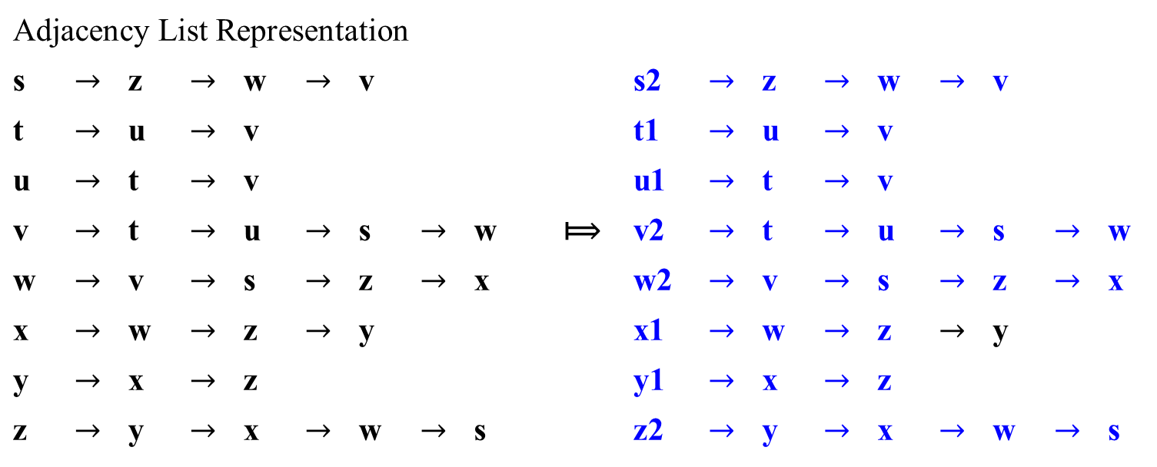
y x t u
y z s t
x w v u
3/?
2/3
1/2
5/?
FIFO Queue Q
s
3/?
2/4
2/5
5/?
z
w
v
Adjacency List Representation
s | $$→$$ | z | $$→$$ | w | $$→$$ | v |  |  |  |  | s2 | $$→$$ | z | $$→$$ | w | $$→$$ | v
t | $$→$$ | u | $$→$$ | v |  |  |  |  |  |  | t1 | $$→$$ | u | $$→$$ | v
u | $$→$$ | t | $$→$$ | v |  |  |  |  |  |  | u1 | $$→$$ | t | $$→$$ | v
v | $$→$$ | t | $$→$$ | u | $$→$$ | s | $$→$$ | w | ⟾ |  | v2 | $$→$$ | t | $$→$$ | u | $$→$$ | s | $$→$$ | w
w | $$→$$ | v | $$→$$ | s | $$→$$ | z | $$→$$ | x |  |  | w2 | $$→$$ | v | $$→$$ | s | $$→$$ | z | $$→$$ | x
x | $$→$$ | w | $$→$$ | z | $$→$$ | y |  |  |  |  | x1 | $$→$$ | w | $$→$$ | z | $$→$$ | y
y | $$→$$ | x | $$→$$ | z |  |  |  |  |  |  | y1 | $$→$$ | x | $$→$$ | z
z | $$→$$ | y | $$→$$ | x | $$→$$ | w | $$→$$ | s |  |  | z2 | $$→$$ | y | $$→$$ | x | $$→$$ | w | $$→$$ | s
y
x
t
u
Figure 3.11

Slide 34
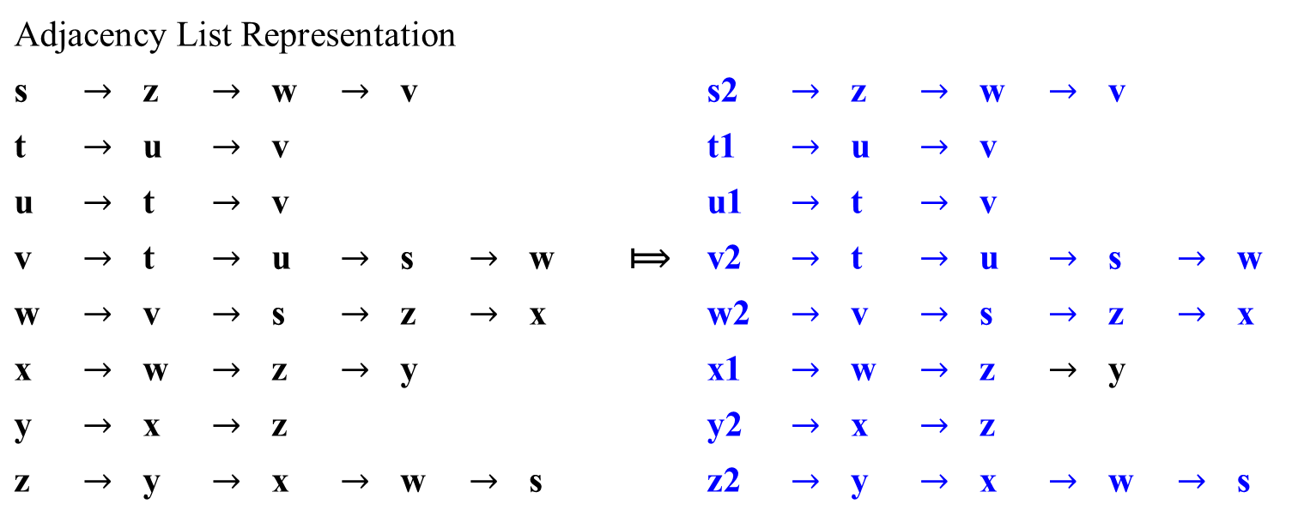
Breadth-First Search on Undirected Graph
y z s t
x w v u
x t u
3/6
2/3
1/2
5/?
FIFO Queue Q
s
3/?
2/4
2/5
5/?
z
w
v
Adjacency List Representation
s | $$→$$ | z | $$→$$ | w | $$→$$ | v |  |  |  |  | s2 | $$→$$ | z | $$→$$ | w | $$→$$ | v
t | $$→$$ | u | $$→$$ | v |  |  |  |  |  |  | t1 | $$→$$ | u | $$→$$ | v
u | $$→$$ | t | $$→$$ | v |  |  |  |  |  |  | u1 | $$→$$ | t | $$→$$ | v
v | $$→$$ | t | $$→$$ | u | $$→$$ | s | $$→$$ | w | ⟾ |  | v2 | $$→$$ | t | $$→$$ | u | $$→$$ | s | $$→$$ | w
w | $$→$$ | v | $$→$$ | s | $$→$$ | z | $$→$$ | x |  |  | w2 | $$→$$ | v | $$→$$ | s | $$→$$ | z | $$→$$ | x
x | $$→$$ | w | $$→$$ | z | $$→$$ | y |  |  |  |  | x1 | $$→$$ | w | $$→$$ | z | $$→$$ | y
y | $$→$$ | x | $$→$$ | z |  |  |  |  |  |  | y2 | $$→$$ | x | $$→$$ | z
z | $$→$$ | y | $$→$$ | x | $$→$$ | w | $$→$$ | s |  |  | z2 | $$→$$ | y | $$→$$ | x | $$→$$ | w | $$→$$ | s
y
x
t
u
Figure 3.11

Slide 35
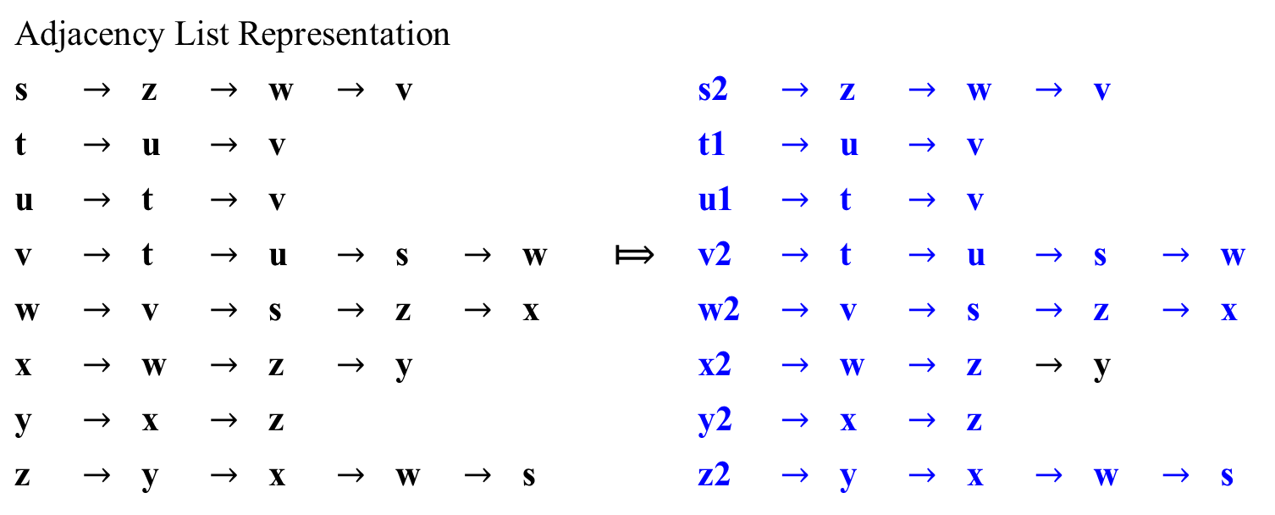
Breadth-First Search on Undirected Graph
y z s t
x w v u
t u
3/6
2/3
1/2
5/?
FIFO Queue Q
s
3/7
2/4
2/5
5/?
z
w
v
Adjacency List Representation
s | $$→$$ | z | $$→$$ | w | $$→$$ | v |  |  |  |  | s2 | $$→$$ | z | $$→$$ | w | $$→$$ | v
t | $$→$$ | u | $$→$$ | v |  |  |  |  |  |  | t1 | $$→$$ | u | $$→$$ | v
u | $$→$$ | t | $$→$$ | v |  |  |  |  |  |  | u1 | $$→$$ | t | $$→$$ | v
v | $$→$$ | t | $$→$$ | u | $$→$$ | s | $$→$$ | w | ⟾ |  | v2 | $$→$$ | t | $$→$$ | u | $$→$$ | s | $$→$$ | w
w | $$→$$ | v | $$→$$ | s | $$→$$ | z | $$→$$ | x |  |  | w2 | $$→$$ | v | $$→$$ | s | $$→$$ | z | $$→$$ | x
x | $$→$$ | w | $$→$$ | z | $$→$$ | y |  |  |  |  | x2 | $$→$$ | w | $$→$$ | z | $$→$$ | y
y | $$→$$ | x | $$→$$ | z |  |  |  |  |  |  | y2 | $$→$$ | x | $$→$$ | z
z | $$→$$ | y | $$→$$ | x | $$→$$ | w | $$→$$ | s |  |  | z2 | $$→$$ | y | $$→$$ | x | $$→$$ | w | $$→$$ | s
y
x
t
u
Figure 3.11

Slide 36
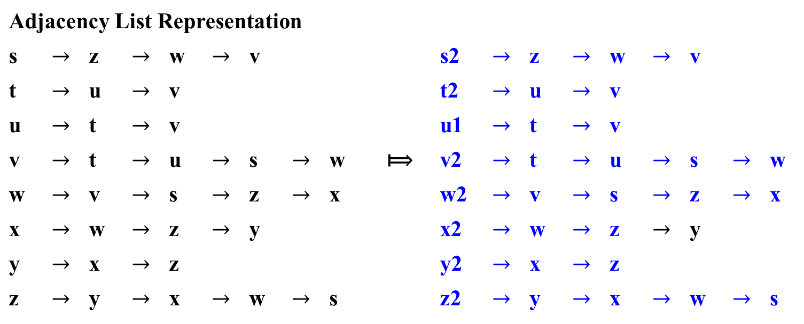
y z s t
x w v u
u
3/6
2/3
1/2
5/8
FIFO Queue Q
s
3/7
2/4
2/5
5/?
z
w
v
Adjacency List Representation
s | $$→$$ | z | $$→$$ | w | $$→$$ | v |  |  |  |  | s2 | $$→$$ | z | $$→$$ | w | $$→$$ | v
t | $$→$$ | u | $$→$$ | v |  |  |  |  |  |  | t2 | $$→$$ | u | $$→$$ | v
u | $$→$$ | t | $$→$$ | v |  |  |  |  |  |  | u1 | $$→$$ | t | $$→$$ | v
v | $$→$$ | t | $$→$$ | u | $$→$$ | s | $$→$$ | w | ⟾ |  | v2 | $$→$$ | t | $$→$$ | u | $$→$$ | s | $$→$$ | w
w | $$→$$ | v | $$→$$ | s | $$→$$ | z | $$→$$ | x |  |  | w2 | $$→$$ | v | $$→$$ | s | $$→$$ | z | $$→$$ | x
x | $$→$$ | w | $$→$$ | z | $$→$$ | y |  |  |  |  | x2 | $$→$$ | w | $$→$$ | z | $$→$$ | y
y | $$→$$ | x | $$→$$ | z |  |  |  |  |  |  | y2 | $$→$$ | x | $$→$$ | z
z | $$→$$ | y | $$→$$ | x | $$→$$ | w | $$→$$ | s |  |  | z2 | $$→$$ | y | $$→$$ | x | $$→$$ | w | $$→$$ | s
y
x
t
u
Figure 3.11

Slide 37

Breadth-First Search on Undirected Graph
y z s t
x w v u
∞
3/6
2/3
1/2
5/8
FIFO Queue Q
s
3/7
2/4
2/5
5/9
z
w
v
Adjacency List Representation
s | $$→$$ | z | $$→$$ | w | $$→$$ | v |  |  |  |  | s2 | $$→$$ | z | $$→$$ | w | $$→$$ | v
t | $$→$$ | u | $$→$$ | v |  |  |  |  |  |  | t2 | $$→$$ | u | $$→$$ | v
u | $$→$$ | t | $$→$$ | v |  |  |  |  |  |  | u2 | $$→$$ | t | $$→$$ | v
v | $$→$$ | t | $$→$$ | u | $$→$$ | s | $$→$$ | w | ⟾ |  | v2 | $$→$$ | t | $$→$$ | u | $$→$$ | s | $$→$$ | w
w | $$→$$ | v | $$→$$ | s | $$→$$ | z | $$→$$ | x |  |  | w2 | $$→$$ | v | $$→$$ | s | $$→$$ | z | $$→$$ | x
x | $$→$$ | w | $$→$$ | z | $$→$$ | y |  |  |  |  | x2 | $$→$$ | w | $$→$$ | z | $$→$$ | y
y | $$→$$ | x | $$→$$ | z |  |  |  |  |  |  | y2 | $$→$$ | x | $$→$$ | z
z | $$→$$ | y | $$→$$ | x | $$→$$ | w | $$→$$ | s |  |  | z2 | $$→$$ | y | $$→$$ | x | $$→$$ | w | $$→$$ | s
y
x
t
u
Figure 3.11

Slide 38
Breadth-First Search on Undirected Graph
Breadth-first search constructs a breadth-first tree,
initially containing only its root, the source vertex s.
Scanning the adjacency list of an already discovered vertex u, the search discovers a white (unvisited v0) vertex v;
Add the vertex v and the edge (u, v) to the breadth-first tree.
The vertex u is the predecessor or parent of v in the tree.
Since a vertex is discovered at most once, it has at most one parent.
Ancestor and descendant relationships in the breadth-first tree are defined relative to the root s as usual: if u is on the simple path in the tree from the root s to vertex v, then u is an ancestor of v and v is a descendant of u.
u
v
s
…
u
…
v

Slide 39

Breadth-First Search
Y
Let the input graph G = (V, E) be represented using adjacency lists.
Let the attribute color[u] to store the color of each vertex u in V.
π[u] is the predecessor of u. If u has no predecessor (e.g., if u = s or u has not been discovered), then π[u] = NIL.
The attribute d[u] holds the distance from the source s to vertex u computed by the algorithm.
The algorithm uses a first-in, first-out queue Q to manage the set of gray vertices.
The breadth-first search procedure BFS is as follows:

Slide 40

Breadth-First Search
Y
Algorithm BFS(G, s)
1 for (each vertex u ε V – {s} of G) {
2 color[u] = WHITE;
3 d[u] = ∞; //distance from the source to u
4 π[u] = NIL; } //end-for
5 color[s] = GRAY; //The vertex s is discovered as the procedure begins
d[s] = 0; //Set the distance vertex s from the root s be 0
π[s] = NIL; //Set the predecessor of s to be NIL
8 Q = Ø; //initialize the FIFO queue Q be empty
9 ENQUEUE(Q, s); //initializes the queue Q containing the vertex s only.
//while-loop iterates as long as Q containing gray vertices,
//which are discovered vertices and have not yet had
//their adjacency lists fully examined.

Slide 41

Breadth-First Search
Y
Algorithm BFS(G, s)
9 …..
10 while (Q ≠ Ø) do { //Q consists the set of gray vertices
u = DEQUEUE(Q); //Remove the gray vertex u from Q in the FIFO order
12 for (each v ɛ Adj[u] of G) do { //consider each v in the adjacency list of u
if (color[v] == WHITE) //if v is white, then it has not yet been discovered.
then { color[v] = GRAY; //and discovers it by executing … color v gray
d[v] = d[u] + 1; //set its distance d[v] to d[u] + 1
π[v] = u; //records u as its parent π[v] and place it at the tail of Q
ENQUEUE(Q, v); } //end if
} //end for
18 color[u] = BLACK; } //end while-do

Slide 42
Analysis of the Algorithm BFS(…)
Let analyze its running time on an input graph G = (V, E).
After initialization, BFS never whitens a vertex again, and
Thus, the test in line 13 ensures that
each vertex is enqueued at most once, and
hence, dequeued at most once.
The operations of enqueuing and dequeuing take O(1) time, and
the total time devoted to queue operation is O(|V|).
The procedure scans each adjacency list at most once, because it scans the adjacency list of each vertex only when the vertex is dequeued.
Since the sum of the lengths of all the adjacency lists is Θ(|E|),
the total time spent in scanning adjacency lists is O(|E|).
Thus, breadth-first search runs in time linear in the size of the adjacency-list representation of G.
The overhead for initialization is O(|V|), and
thus the total running time of the BFS procedure is O(|V| + |E|).

Slide 43
Breadth-First Search
Use a queue (note the different from DFS) to trace the operation of breadth-first search.
The queue is initialized Q = (u) with the traversal’s starting vertex u (white), which is marked as visited (gray).
On each iteration, the algorithm
identifies all unvisited vertices {v_{i} }(white) that are adjacent to the front the vertex u (gray),
Marks (gray) them {v_{i} } as visited, and
adds them to the queue; Q = (u, …, v_{i} )
after that, the vertex (black) at the front of the queue is removed from the queue. Q = ( …, v_{i} )
u
v_{i}
BFS requires a linear bounded Automaton with markers.

Slide 44
Breadth-First Search
Similarly to a DFS traversal, accompanying a BFS traversal,
the so-called breadth-first search forest is constructed
The traversal’s starting vertex serves as the root of the first tree in such a forest.
Whenever a new unvisited vertex is reached for the first time, the vertex is attached as a child to the vertex it is being reached from with an edge called a tree edge.
If an edge leading to a previously visited vertex other than its immediate predecessor (i.e., its parent in the tree) is encountered, the edge is noted as a cross edge.

Slide 45
Breadth-First Search on Directed Graph

Slide 46
Depth-First Search
s → z → w
t → v → u
u → v → t
v → w → s
w → x
x → z
y → x
z → y → w
y z s t
3/6
2/9
1/10
11/16
B F C B
4/5
7/8
12/13
14/15
C C C
x w v u
Stack Top
X_{4,5}
Y_{3,6} W_{7,8}
Z_{2,9} V_{12,13} U_{14,15}
S_{1,10} T_{11,16}
Figure 3.10

Slide 47
Depth-First Search
s → z → w
t → v → u
u → v → t
v → w → s
w → x
x → z
y → x
z → y → w
y z s t
B F C B
C C C
x w v u
F C
B B
C C
C
3/6
2/9
1/10
11/16
4/5
7/8
12/13
14/15
1/10 s
2/9 z
11/16 t
3/6 y
7/8 w
12/13 v
14/15 u
4/5 x
Figure 3.10
DFS Traversal’s Tree Forest Structure

Slide 48
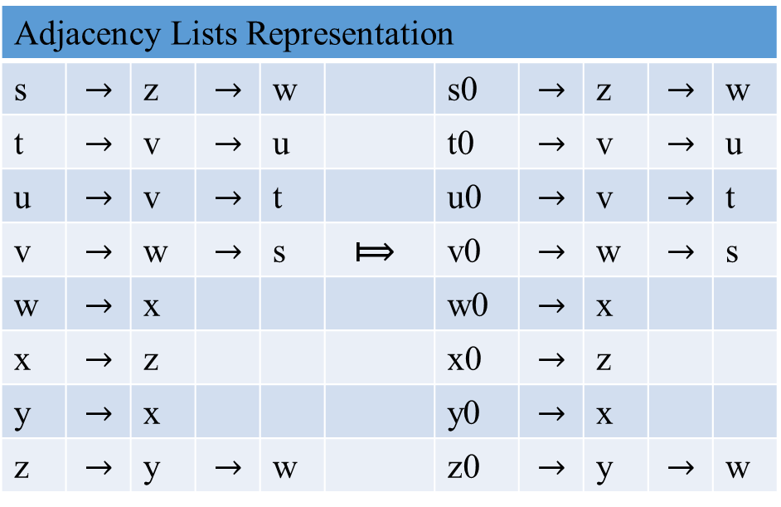
Breadth-First Search on digraph
y z s t
x w v u
?/?
?/?
?/?
?/?
∞ | FIFO Queue Q
?/?
?/?
?/?
?/?
Adjacency Lists Representation
s | $$→$$ | z | $$→$$ | w |  | s0 | $$→$$ | z | $$→$$ | w
t | $$→$$ | v | $$→$$ | u |  | t0 | $$→$$ | v | $$→$$ | u
u | $$→$$ | v | $$→$$ | t |  | u0 | $$→$$ | v | $$→$$ | t
v | $$→$$ | w | $$→$$ | s | ⟾ | v0 | $$→$$ | w | $$→$$ | s
w | $$→$$ | x |  |  |  | w0 | $$→$$ | x
x | $$→$$ | z |  |  |  | x0 | $$→$$ | z
y | $$→$$ | x |  |  |  | y0 | $$→$$ | x
z | $$→$$ | y | $$→$$ | w |  | z0 | $$→$$ | y | $$→$$ | w
Figure 3.10
What is BFS Traversal?

Slide 49
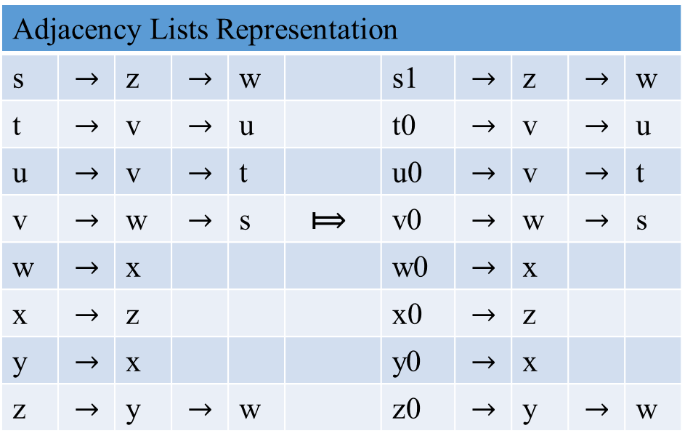
Breadth-First Search on digraph
y z s t
x w v u
Figure 3.10
What is BFS Traversal?
?/?
?/?
1/?
?/?
s | FIFO Queue Q
?/?
?/?
?/?
?/?
Adjacency Lists Representation
s | $$→$$ | z | $$→$$ | w |  | s1 | $$→$$ | z | $$→$$ | w
t | $$→$$ | v | $$→$$ | u |  | t0 | $$→$$ | v | $$→$$ | u
u | $$→$$ | v | $$→$$ | t |  | u0 | $$→$$ | v | $$→$$ | t
v | $$→$$ | w | $$→$$ | s | ⟾ | v0 | $$→$$ | w | $$→$$ | s
w | $$→$$ | x |  |  |  | w0 | $$→$$ | x
x | $$→$$ | z |  |  |  | x0 | $$→$$ | z
y | $$→$$ | x |  |  |  | y0 | $$→$$ | x
z | $$→$$ | y | $$→$$ | w |  | z0 | $$→$$ | y | $$→$$ | w
s

Slide 50
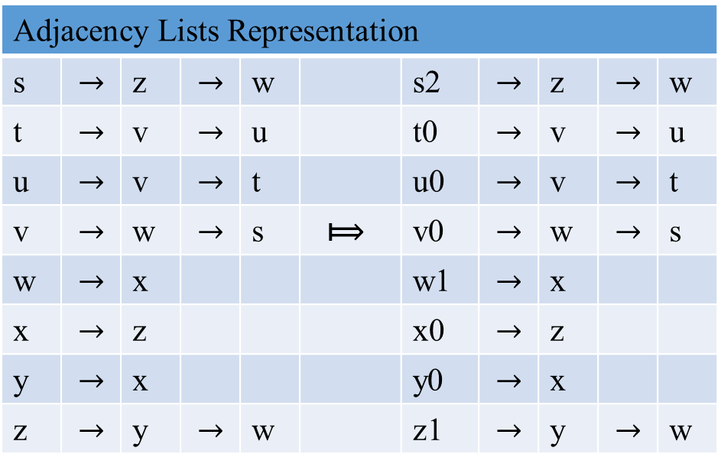
Breadth-First Search on digraph
y z s t
x w v u
Figure 3.10
What is BFS Traversal?
?/?
2/?
1/2
?/?
zw | FIFO Queue Q
?/?
2/?
?/?
?/?
Adjacency Lists Representation
s | $$→$$ | z | $$→$$ | w |  | s2 | $$→$$ | z | $$→$$ | w
t | $$→$$ | v | $$→$$ | u |  | t0 | $$→$$ | v | $$→$$ | u
u | $$→$$ | v | $$→$$ | t |  | u0 | $$→$$ | v | $$→$$ | t
v | $$→$$ | w | $$→$$ | s | ⟾ | v0 | $$→$$ | w | $$→$$ | s
w | $$→$$ | x |  |  |  | w1 | $$→$$ | x
x | $$→$$ | z |  |  |  | x0 | $$→$$ | z
y | $$→$$ | x |  |  |  | y0 | $$→$$ | x
z | $$→$$ | y | $$→$$ | w |  | z1 | $$→$$ | y | $$→$$ | w
s
z
w

Slide 51
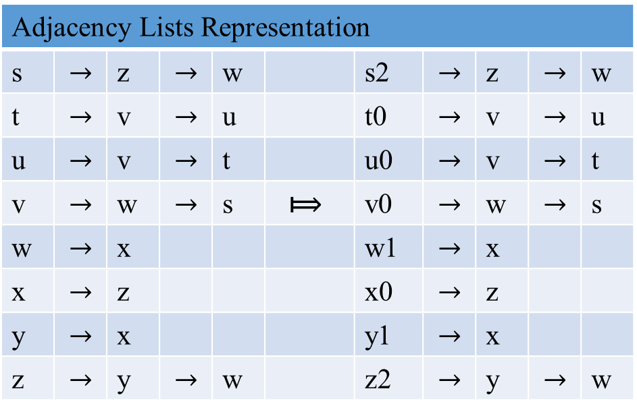
Breadth-First Search on digraph
y z s t
C
x w v u
Figure 3.10
What is BFS Traversal?
3/?
2/3
1/2
?/?
wyw | FIFO Queue Q
?/?
2/?
?/?
?/?
Adjacency Lists Representation
s | $$→$$ | z | $$→$$ | w |  | s2 | $$→$$ | z | $$→$$ | w
t | $$→$$ | v | $$→$$ | u |  | t0 | $$→$$ | v | $$→$$ | u
u | $$→$$ | v | $$→$$ | t |  | u0 | $$→$$ | v | $$→$$ | t
v | $$→$$ | w | $$→$$ | s | ⟾ | v0 | $$→$$ | w | $$→$$ | s
w | $$→$$ | x |  |  |  | w1 | $$→$$ | x
x | $$→$$ | z |  |  |  | x0 | $$→$$ | z
y | $$→$$ | x |  |  |  | y1 | $$→$$ | x
z | $$→$$ | y | $$→$$ | w |  | z2 | $$→$$ | y | $$→$$ | w
s
z
w
y

Slide 52
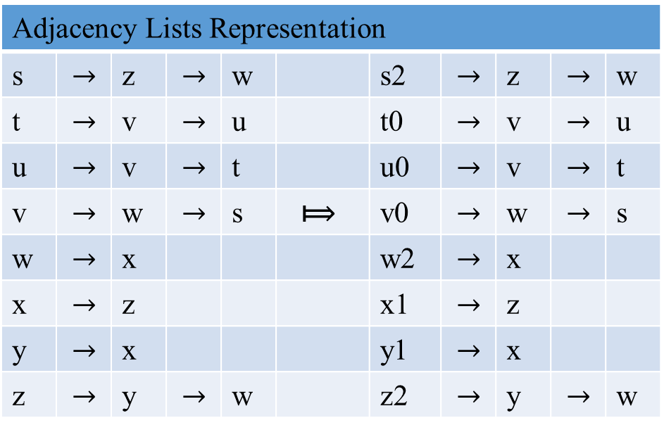
Breadth-First Search on digraph
y z s t
C
x w v u
Figure 3.10
What is BFS Traversal?
3/?
2/3
1/2
?/?
ywx | FIFO Queue Q
4/?
2/4
?/?
?/?
Adjacency Lists Representation
s | $$→$$ | z | $$→$$ | w |  | s2 | $$→$$ | z | $$→$$ | w
t | $$→$$ | v | $$→$$ | u |  | t0 | $$→$$ | v | $$→$$ | u
u | $$→$$ | v | $$→$$ | t |  | u0 | $$→$$ | v | $$→$$ | t
v | $$→$$ | w | $$→$$ | s | ⟾ | v0 | $$→$$ | w | $$→$$ | s
w | $$→$$ | x |  |  |  | w2 | $$→$$ | x
x | $$→$$ | z |  |  |  | x1 | $$→$$ | z
y | $$→$$ | x |  |  |  | y1 | $$→$$ | x
z | $$→$$ | y | $$→$$ | w |  | z2 | $$→$$ | y | $$→$$ | w
s
z
w
y
x

Slide 53

Breadth-First Search on digraph
y z s t
C C
x w v u
Figure 3.10
What is BFS Traversal?
3/5
2/3
1/2
?/?
wxx | FIFO Queue Q
4/?
2/4
?/?
?/?
Adjacency Lists Representation
s | $$→$$ | z | $$→$$ | w |  | s2 | $$→$$ | z | $$→$$ | w
t | $$→$$ | v | $$→$$ | u |  | t0 | $$→$$ | v | $$→$$ | u
u | $$→$$ | v | $$→$$ | t |  | u0 | $$→$$ | v | $$→$$ | t
v | $$→$$ | w | $$→$$ | s | ⟾ | v0 | $$→$$ | w | $$→$$ | s
w | $$→$$ | x |  |  |  | w2 | $$→$$ | x
x | $$→$$ | z |  |  |  | x1 | $$→$$ | z
y | $$→$$ | x |  |  |  | y2 | $$→$$ | x
z | $$→$$ | y | $$→$$ | w |  | z2 | $$→$$ | y | $$→$$ | w
s
z
w
y
x

Slide 54

Breadth-First Search on digraph
y z s t
C C C
x w v u
Figure 3.10
What is BFS Traversal?
3/5
2/3
1/2
?/?
xz ∞ | FIFO Queue Q
4/6
2/4
?/?
?/?
Adjacency Lists Representation
s | $$→$$ | z | $$→$$ | w |  | s2 | $$→$$ | z | $$→$$ | w
t | $$→$$ | v | $$→$$ | u |  | t0 | $$→$$ | v | $$→$$ | u
u | $$→$$ | v | $$→$$ | t |  | u0 | $$→$$ | v | $$→$$ | t
v | $$→$$ | w | $$→$$ | s | ⟾ | v0 | $$→$$ | w | $$→$$ | s
w | $$→$$ | x |  |  |  | w2 | $$→$$ | x
x | $$→$$ | z |  |  |  | x2 | $$→$$ | z
y | $$→$$ | x |  |  |  | y2 | $$→$$ | x
z | $$→$$ | y | $$→$$ | w |  | z2 | $$→$$ | y | $$→$$ | w
s
z
w
y
x

Slide 55
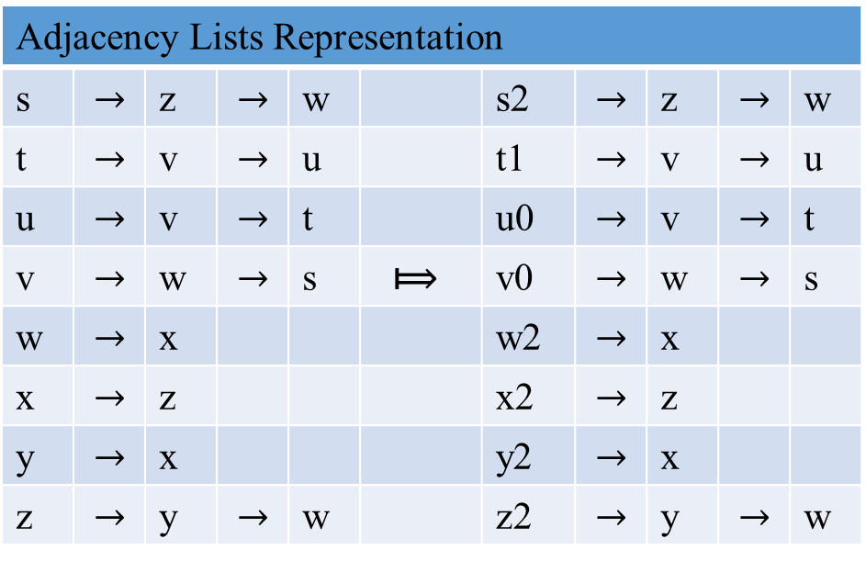
Breadth-First Search on digraph
y z s t
C C C
x w v u
Figure 3.10
What is BFS Traversal?
3/5
2/3
1/2
7/?
t | FIFO Queue Q
4/6
2/4
?/?
?/?
Adjacency Lists Representation
s | $$→$$ | z | $$→$$ | w |  | s2 | $$→$$ | z | $$→$$ | w
t | $$→$$ | v | $$→$$ | u |  | t1 | $$→$$ | v | $$→$$ | u
u | $$→$$ | v | $$→$$ | t |  | u0 | $$→$$ | v | $$→$$ | t
v | $$→$$ | w | $$→$$ | s | ⟾ | v0 | $$→$$ | w | $$→$$ | s
w | $$→$$ | x |  |  |  | w2 | $$→$$ | x
x | $$→$$ | z |  |  |  | x2 | $$→$$ | z
y | $$→$$ | x |  |  |  | y2 | $$→$$ | x
z | $$→$$ | y | $$→$$ | w |  | z2 | $$→$$ | y | $$→$$ | w
s
t
z
w
y
x

Slide 56
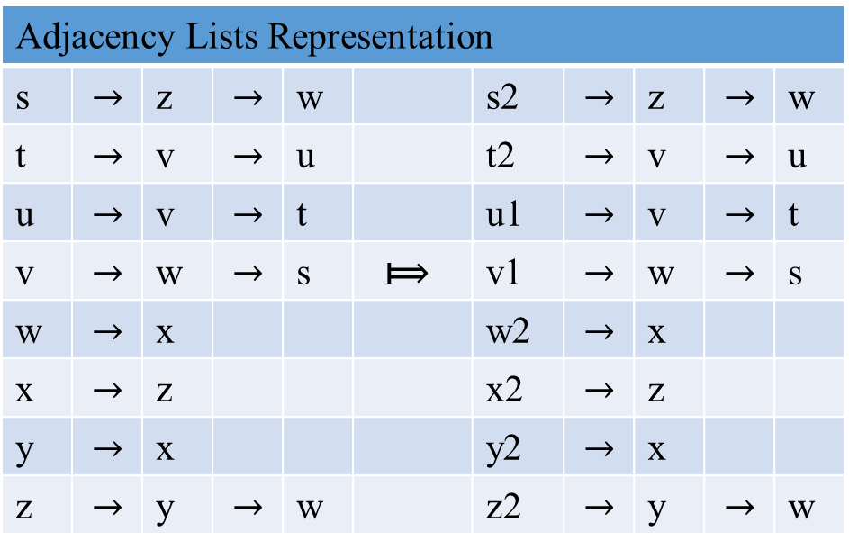
Breadth-First Search on digraph
Figure 3.10
What is BFS Traversal?
y z s t
C C C
x w v u
3/5
2/3
1/2
7/8
vu | FIFO Queue Q
4/6
2/4
8/?
8/?
Adjacency Lists Representation
s | $$→$$ | z | $$→$$ | w |  | s2 | $$→$$ | z | $$→$$ | w
t | $$→$$ | v | $$→$$ | u |  | t2 | $$→$$ | v | $$→$$ | u
u | $$→$$ | v | $$→$$ | t |  | u1 | $$→$$ | v | $$→$$ | t
v | $$→$$ | w | $$→$$ | s | ⟾ | v1 | $$→$$ | w | $$→$$ | s
w | $$→$$ | x |  |  |  | w2 | $$→$$ | x
x | $$→$$ | z |  |  |  | x2 | $$→$$ | z
y | $$→$$ | x |  |  |  | y2 | $$→$$ | x
z | $$→$$ | y | $$→$$ | w |  | z2 | $$→$$ | y | $$→$$ | w
s
t
z
w
v
u
y
x

Slide 57

Breadth-First Search on digraph
Figure 3.10
What is BFS Traversal?
y z s t
C C C C
C
x w v u
3/5
2/3
1/2
7/8
u | FIFO Queue Q
4/6
2/4
8/9
8/?
Adjacency Lists Representation
s | $$→$$ | z | $$→$$ | w |  | s2 | $$→$$ | z | $$→$$ | w
t | $$→$$ | v | $$→$$ | u |  | t2 | $$→$$ | v | $$→$$ | u
u | $$→$$ | v | $$→$$ | t |  | u1 | $$→$$ | v | $$→$$ | t
v | $$→$$ | w | $$→$$ | s | ⟾ | v2 | $$→$$ | w | $$→$$ | s
w | $$→$$ | x |  |  |  | w2 | $$→$$ | x
x | $$→$$ | z |  |  |  | x2 | $$→$$ | z
y | $$→$$ | x |  |  |  | y2 | $$→$$ | x
z | $$→$$ | y | $$→$$ | w |  | z2 | $$→$$ | y | $$→$$ | w
s
t
z
w
v
u
y
x

Slide 58
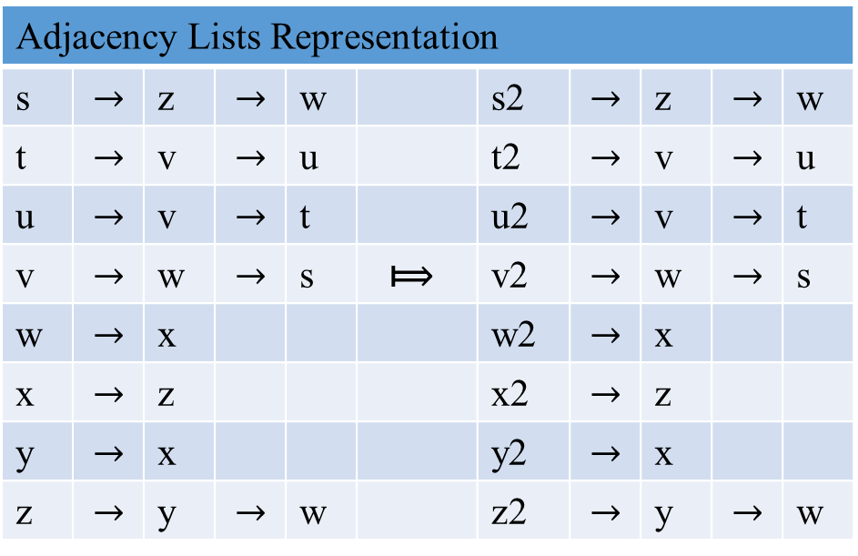
Breadth-First Search on digraph
y z s t
C C C C B
C C
x w v u
Figure 3.10
What is BFS Traversal?
3/5
2/3
1/2
7/8
∞ | FIFO Queue Q
4/6
2/4
8/9
8/10
Adjacency Lists Representation
s | $$→$$ | z | $$→$$ | w |  | s2 | $$→$$ | z | $$→$$ | w
t | $$→$$ | v | $$→$$ | u |  | t2 | $$→$$ | v | $$→$$ | u
u | $$→$$ | v | $$→$$ | t |  | u2 | $$→$$ | v | $$→$$ | t
v | $$→$$ | w | $$→$$ | s | ⟾ | v2 | $$→$$ | w | $$→$$ | s
w | $$→$$ | x |  |  |  | w2 | $$→$$ | x
x | $$→$$ | z |  |  |  | x2 | $$→$$ | z
y | $$→$$ | x |  |  |  | y2 | $$→$$ | x
z | $$→$$ | y | $$→$$ | w |  | z2 | $$→$$ | y | $$→$$ | w
s
t
z
w
v
u
y
x

Slide 59
The following Table 3.1 summarizes the main facts about DFS and BFS:
Table 3.1: Main facts about DFS and BFS
 | DFS | BFS
Data Structure | Stack (LIFO Queue) | FIFO Queue
No. of vertex orderings | 2 orderings | 1 ordering
Edge types (undirected graphs) | Tree and back edges | Tree and cross edges
Applications | Connectivity, Acyclicity, Articulation points | Connectivity, Acyclicity Minimum-edge paths
Efficiency for adjacent Matrix | Θ(|V| ² ) | Θ(|V| ² )
Efficiency for adjacent lists | Θ(|V| + |E| ) | Θ(|V| + |E| )

Slide 60
Shortest paths
The breadth-first search
finds the distance to each reachable vertex in a graph G = (V, E) from a given source vertex s ε V.
Define the shortest-path distance δ(s, v) from s to v as
the minimum number of edges in any path from vertex s to vertex v;
if there is no path from s to v, then δ(s, v) = ∞.
A path of length δ(s, v) from s to v is said to be a shortest path from s to v.
An important property of shortest-path distances

Slide 61
Breadth-First Search - Shortest Path
BSF can be helpful in some situations where DFS cannot.
BFS can be used for finding a path with the fewest number of edges between two given vertices.
Start a BFS traversal at one of the two vertices given and
stop the BFS traversal when the other vertex is reached.
The simple path from the root of the BFS tree to the second vertex is the path sought.
The correctness of this application appears to stem immediately from the way BFS operates; but a mathematical proof of its validity is not quite obvious.

Slide 62
Breadth-First Search - Shortest Path
The simple path from the root of the BFS tree to the second vertex is the path sought.
Figure 3.11: the path s – v – t in the undirected graph has the fewest number of edges among all the paths between vertices s and t. Also, s – z – x is the shortest path between vertices s and x.
Figure 3.10: the path s – w – x in the directed graph has the fewest number of edges among all the paths between vertices s and x.
Example 3.8: the path a – e – b in the undirected graph has the fewest number of edges among all the paths between vertices a and b.
Figure 3.10: the path s – w – x in the directed graph has the fewest number of edges among all the paths between vertices s and x.
The correctness of this application appears to stem immediately from the way BFS operates; but a mathematical proof of its validity is not quite obvious.

Slide 63
Breadth-First Search - Shortest Path
Lemma 3.3
Let G = (V, E) be a directed or undirected graph. Let s ε V be an arbitrary vertex. Then for any edge (u, v) ε E,
δ(s, v) ≤ δ(s, u) + 1.
Proof: If u is reachable from s, then so is v. In this case the shortest path from s to v cannot be longer than the shortest path from s to u followed by the edge (u, v), and thus the inequality holds. If u is not reachable from s, then δ(s, u) = ∞, and the equality holds.
s
If not δ(s, v) is not the shortest distance.
δ(s, v)
u
v
δ(s, u) + 1
QED

Slide 64
Breadth-First Search - Shortest Path
Let d[v] be the distance from the source s to vertex v, computed by the algorithm.
We want to show that BFS properly computes d[v] = δ(s, v) for each vertex v ε V. We first show that d[v] bounds δ(s, v) from above.
Lemma 3.4
Let G = (V, E) be a directed or undirected graph. Suppose that BFS is run on G from a given source vertex s ε V. Then upon termination, for each vertex v ε V, the value d[v] computed by BFS satisfies d[v] ≥ δ(s, v).
Proof: Use induction on the number of ENQUEUE operations. An inductive hypothesis is that d[v] ≥ δ(s, v) for all v ε V.

Slide 65
Breadth-First Search - Shortest Path
To prove that d[v] = δ(s, v), we must first show more precisely how the queue Q operated during the course of BFS. The next lemma shows that at all times, there are at most two distinct d values in the queue.
Lemma 3 .5
Suppose that during the execution of BFS on a graph G = (V, E), the queue Q contains the vertices <v₁, v₂, … v_{r} >, where v₁ is the head of Q and v_{r} is the tail. Then d[v_{r} ] ≤ d[v₁ ] + 1 and d[v_{i} ] ≤ d[v_{i+1} ] for i = 1, 2, …, r-1.

Slide 66
Breadth-First Search - Shortest Path
Corollary 3 .5L.
Suppose that vertices v_{i} and v_{j} are enqueued during the execution of BFS, and v_{i} is enqueued before v_{j}. Then d[v_{i} ] ≤ d[v_{j} ] at the time that v_{j} is enqueued.
Proof: Immediate from Lemma 3 .5 and the property that each vertex receives a finite d value at most once during the course of BFS.

Slide 67
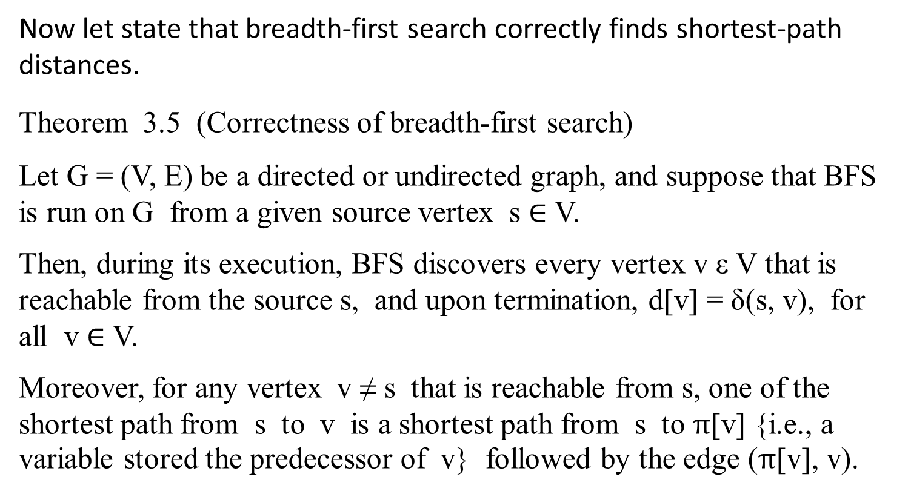
Breadth-First Search - Shortest Path
Now let state that breadth-first search correctly finds shortest-path distances.
Theorem 3.5 (Correctness of breadth-first search)
Let G = (V, E) be a directed or undirected graph, and suppose that BFS is run on G from a given source vertex s $∈$ V.
Then, during its execution, BFS discovers every vertex v ε V that is reachable from the source s, and upon termination, d[v] = δ(s, v), for all v $∈$ V.
Moreover, for any vertex v ≠ s that is reachable from s, one of the shortest path from s to v is a shortest path from s to π[v] {i.e., a variable stored the predecessor of v} followed by the edge (π[v], v).

Slide 68
Breadth-First Trees
The procedure BFS builds a breadth-first tree as it searches the graph, as illustrated in previous Figure 3.11. The tree is represented by the π attributes.
Formally, for a graph G = (V, E) with source s, define the predecessor subgraph of G as G_{π} = (V_{π} , E_{π} ) where
V_{π} = { v ε V | π[v] ≠ NIL } U { s }
and
E_{π} = { (π[v], v) | v ε V_{π} – { s } }.

Slide 69
Breadth-First Trees
The predecessor subgraph G_{π} is a breadth-first tree
if V_{π} consists of the vertices reachable from s and for all v ε V_{π}, the subgraph G_{π} contains a unique simple path from s to v that is also a shortest path from s to v in G.
A breadth-first tree is in fact a tree, since it is connected and | E_{π} | = | V_{π} | - 1 (see Theorem 3.6 (Properties of free trees)). The edges in E_{π} are called tree edges.

Slide 70
Breadth-First Trees
The following lemmas shows that the predecessor subgraph produced by the algorithm BFS(G, s) is a breadth-first tree.
Lemma 3.6
When applied to a directed or undirected graph G = (V, E), the algorithm BFS(G, s) constructs π so that the predecessor subgraph G_{π} = (V_{π} , E_{π} ) is a breadth-first tree.

Slide 71
Recall
Graph:
A directed graph or digraph is a graph with directions specified for all its edges.
The adjacency matrix and adjacency lists are still two principal means of representing a digraph.

Slide 72
Topological Sorting

